Slide 1
“Air B ‘n’ B”
Edinburgh, Scotland
Presented by: Matthew R. Ellwood
Last Updated: 23rd November 2022
Notes:
This presentation was drawn from the request by the Managers at “Cyclistic” in Chicago. A Bike Share company operating from numerous areas across the city..

Slide 2
Table of contents
“Air BnB”
•1. Do different neighbourhoods influence the prices charged ?
•2. Do the Amenities of the property influence the prices charged ?
•3. Creating answers from the data
•4. Conclusion
Notes:
What we are going to view today is firstly, How Annual members of the company and Casual riders use the bikes differently
Next, we will show you what we did to find the answers from the data supplied, and then formulate the conclusions.

Slide 3
Do different neighbourhoods influence the prices charged ?
Using data stored on the Air Bnb Public Data website.
Notes:
How do the members and casual riders use the system differently

Slide 4
Searching the data for any correlation
Notes:
We began by searching through all the data for any correlations

Slide 5
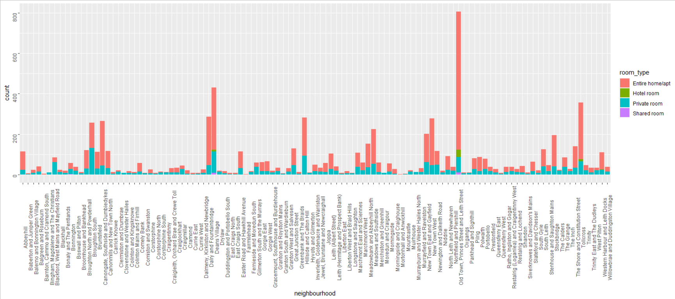



The quantity of available accomodation in the different neighbourhoods of Edinburgh.
Old Town, Princes Street & Leith Street
Deans Village
Notes:
This chart shows the difference between the casual riders shown in red, and the members shown in green, against each weekday, and how long each groups rides lasted.
The results show that the casual riders used the bikes for a lot longer trips than the members, across each and every weekday.

Slide 6






Leith Street
Princes Street

Slide 7
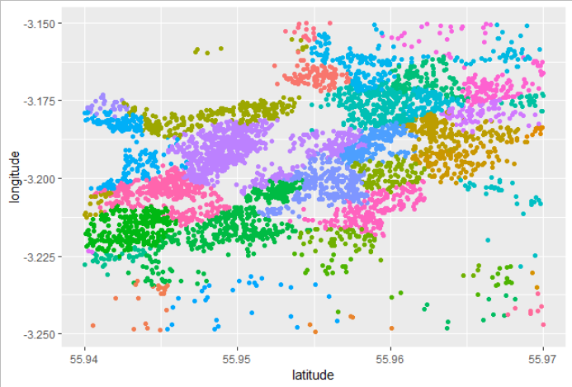
Central Edinburgh Accommodation By Neighbourhood.

Slide 8
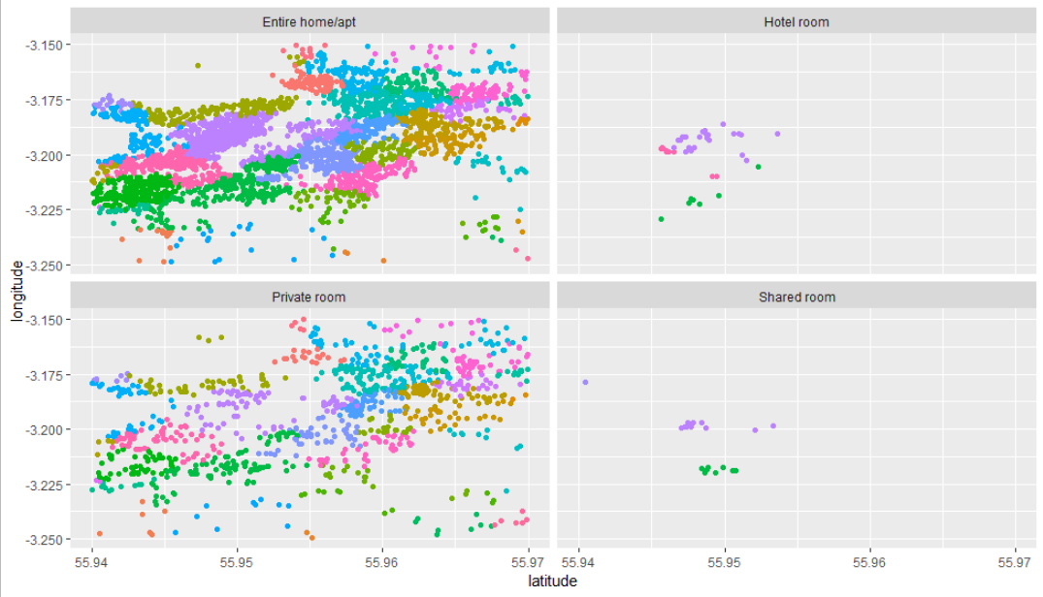
Central Edinburgh Accomodation By Accomodation type and Neighbourhood.

Slide 9
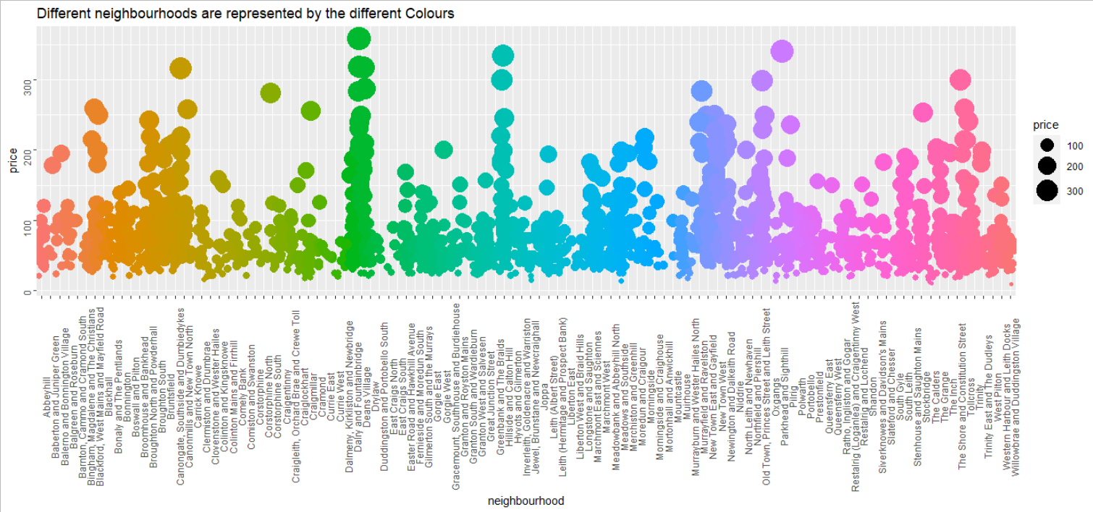
Private Rooms under £375

Slide 10
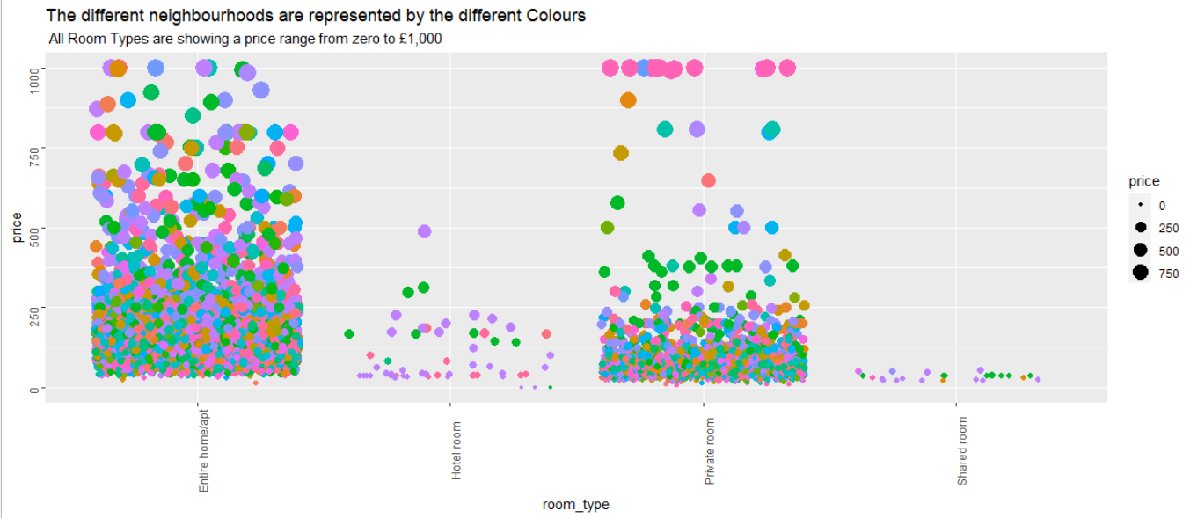
The Price Ranges against the room types, the colours are the different neighbourhoods

Slide 11


The Price Ranges against the room types, the colours are the different neighbourhoods

Slide 12
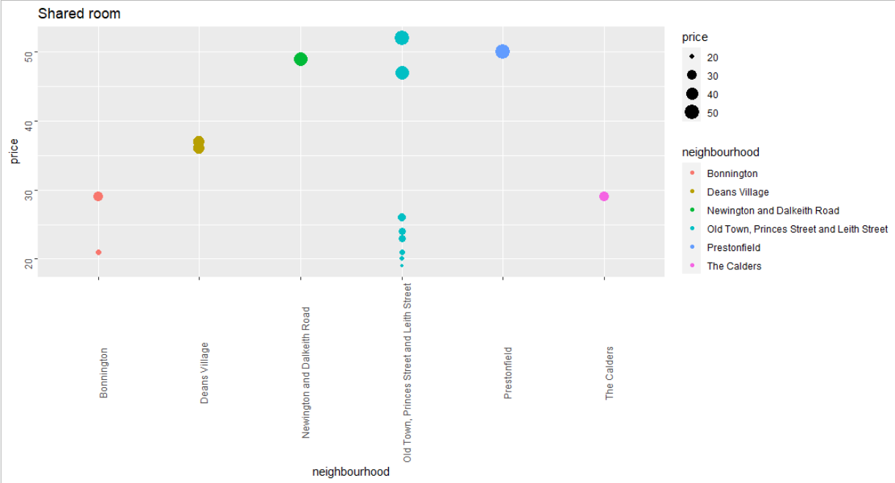
Price of Shared rooms by Neighbourhood

Slide 13

The Price Ranges against the room types, the colours are the different neighbourhoods

Slide 14
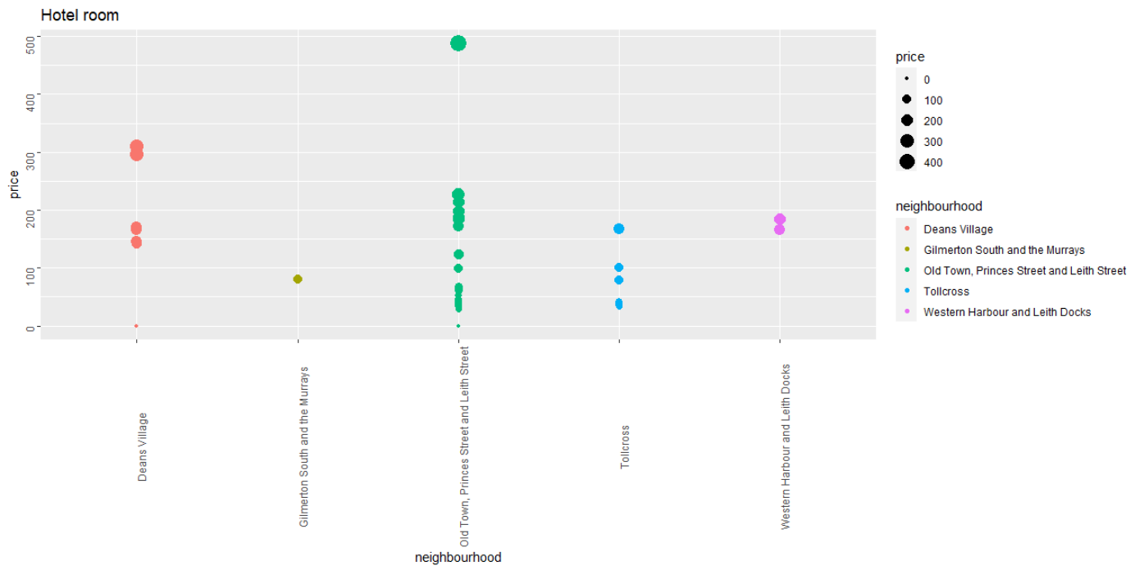
Price of Hotel rooms by Neighbourhood

Slide 15
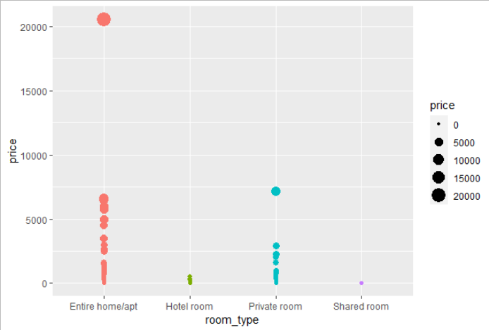
Do the Amenities of the property influence the prices charged ?

Slide 16
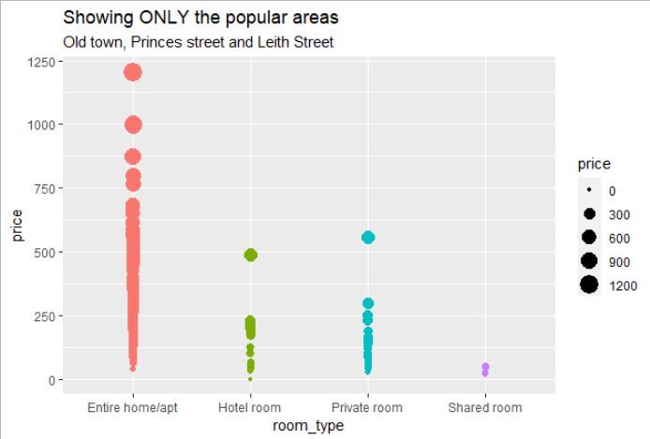
Do the Amenities of the property influence the prices charged ?

Slide 17
Conclusions
1. Do different neighbourhoods influence the prices charged ?
YES, certain areas like Princes St, Leith St. and Old Town are some of the popular areas, and can be more expensive, depending on the type of accommodation .
They also have more choice of accommodation in all the differing types.

Slide 18
Conclusions
Do the Amenities of the property influence the prices charged ?
Yes, the Entire home/apartments are among the highest prices of all property types available.
The shared rooms are by far the cheapest, but only available in certain locations, the price is held low in the popular locations because of the Amenities of the accommodation on offer.

